Slide 1
ER Diagram Example
Draw an ER diagram for a Company based on the conditions specified as follows:
A company has several departments. Each department may have several Locations.
Departments are identified by a name, d_no, Location.
A Manager control a particular department.
Each department is associated with number of projects.
Employees are identified by name, id, address, job, date_of_joining.
An employee works in only one department but can work on several project.
We also keep track of number of hours worked by an employee on a single project.
Each employee has a dependent
Dependent has D_name, Gender, and relationship.

Slide 2
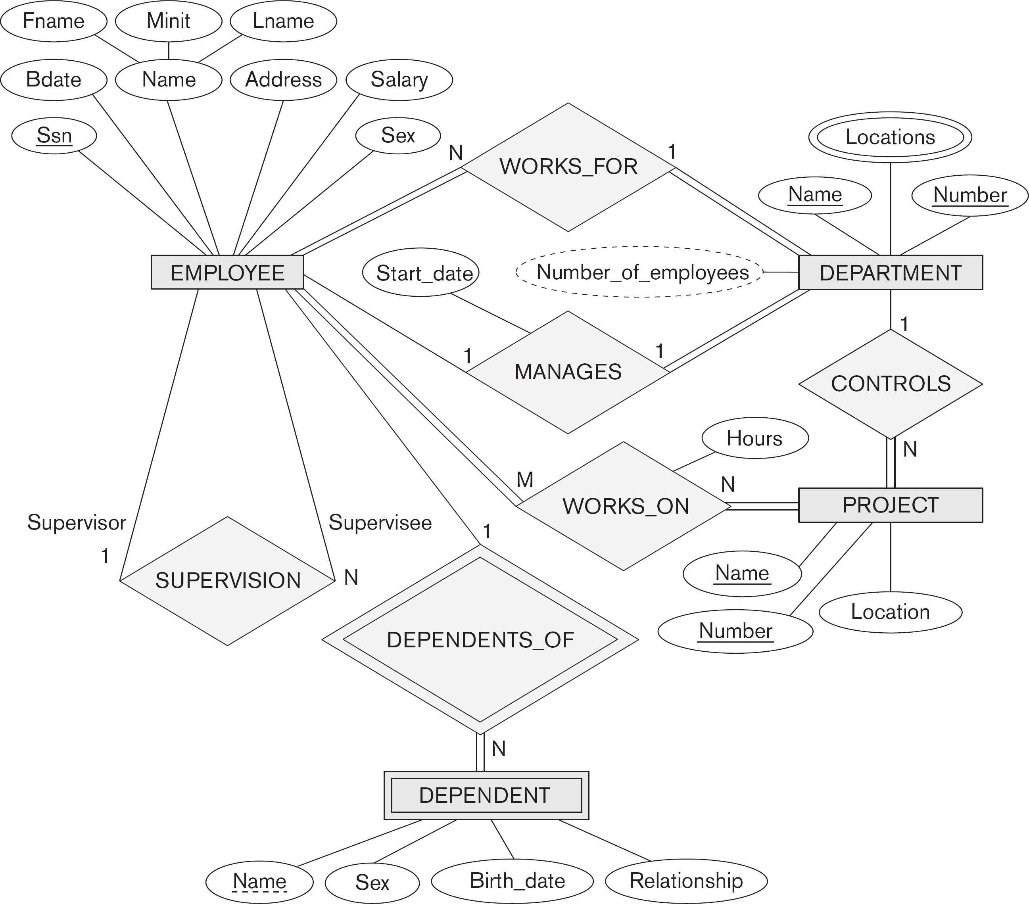

Slide 3
ER-to-Relational Mapping
CS3200 – Database Design· ·· Spring 2018· ·· Derbinsky

Slide 4
Example ERD
CS3200 – Database Design· ·· Spring 2018· ·· Derbinsky

Slide 5
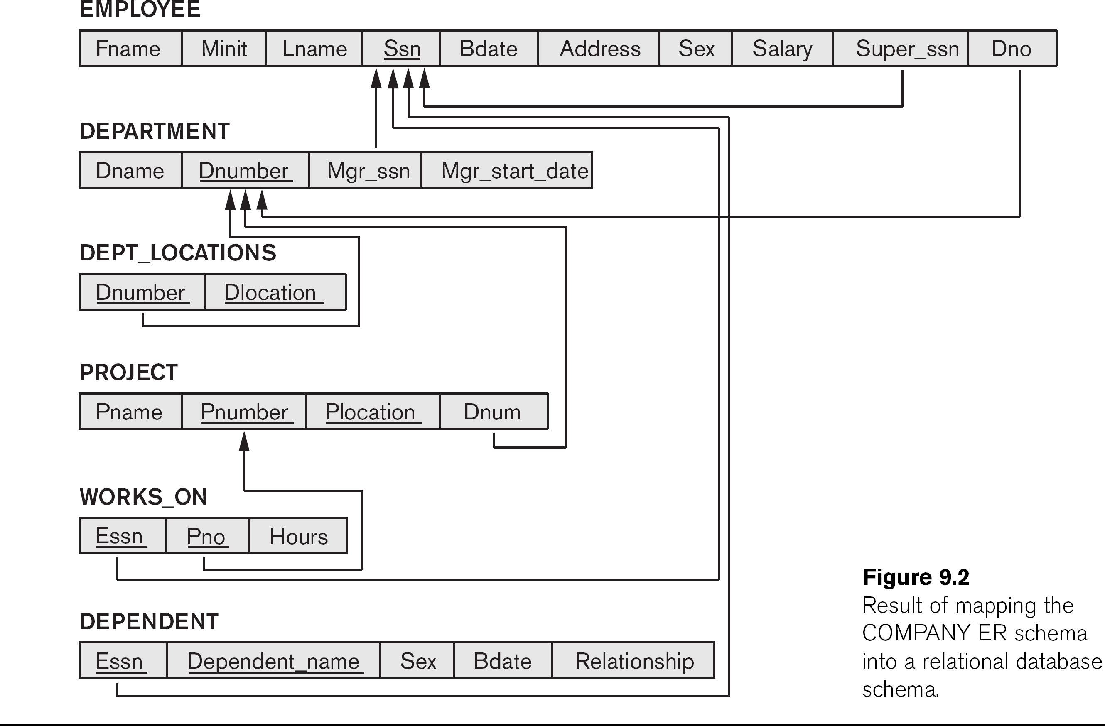
Resulting Relational Schema
CS3200 – Database Design· ·· Spring 2018· ·· Derbinsky

Slide 6
Step 1: Regular Entity Types
CS3200 – Database Design· ·· Spring 2018· ·· Derbinsky
For each regular/strong entity type, create a corresponding relation that includes all the simple attributes (includes simple attributes of composite relations)
Choose one of the key attributes as primary
If composite, the simple attributes together form the primary key
Any remaining key attributes are kept as secondary unique keys (these will be useful for physical tuning w.r.t. indexing analysis)

Slide 7
Example ERD
CS3200 – Database Design· ·· Spring 2018· ·· Derbinsky

Slide 8
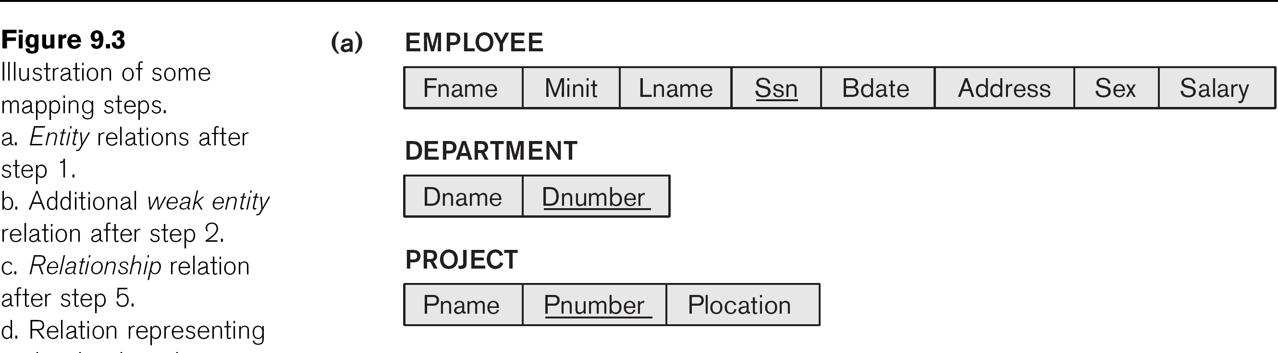
Step 1 Result
CS3200 – Database Design· ·· Spring 2018· ·· Derbinsky

Slide 9
Step 2: Weak Entity Types
CS3200 – Database Design· ·· Spring 2018· ·· Derbinsky
For each weak entity type, create a corresponding relation that includes all the simple attributes
Add as a foreign key all of the primary key attribute(s) in the entity corresponding to the owner entity type
The primary key is the combination of all the primary key attributes from the owner and the partial key of the weak entity, if any

Slide 10
Example ERD
CS3200 – Database Design· ·· Spring 2018· ·· Derbinsky

Slide 11
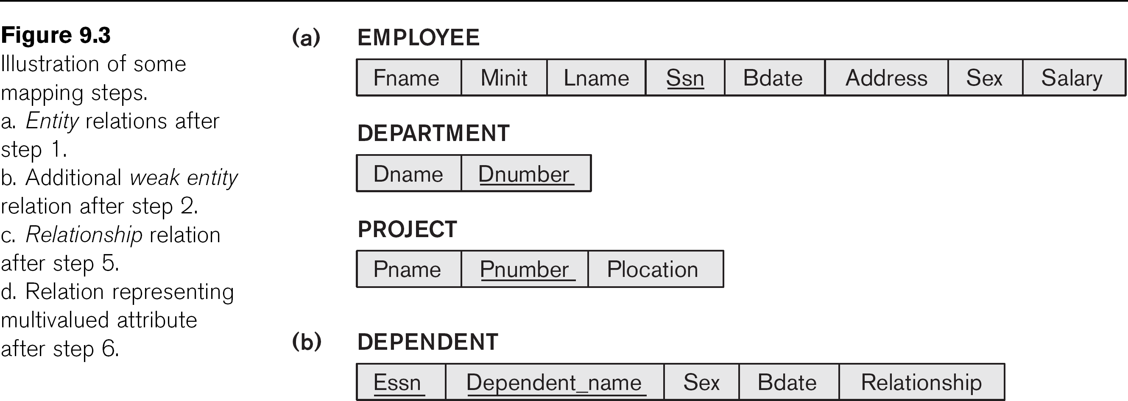
Step 2 Result
CS3200 – Database Design· ·· Spring 2018· ·· Derbinsky

Slide 12
Step 3: Mapping Binary 1-to-1
CS3200 – Database Design· ·· Spring 2018· ·· Derbinsky
Foreign Key
Choose one relation as S, the other T
Better if S has total participation (reduces number of NULL values)
Add to S all the simple attributes of the relationship
Add as a foreign key in S the primary key attributes of T

Slide 13
Example ERD
CS3200 – Database Design· ·· Spring 2018· ·· Derbinsky

Slide 14
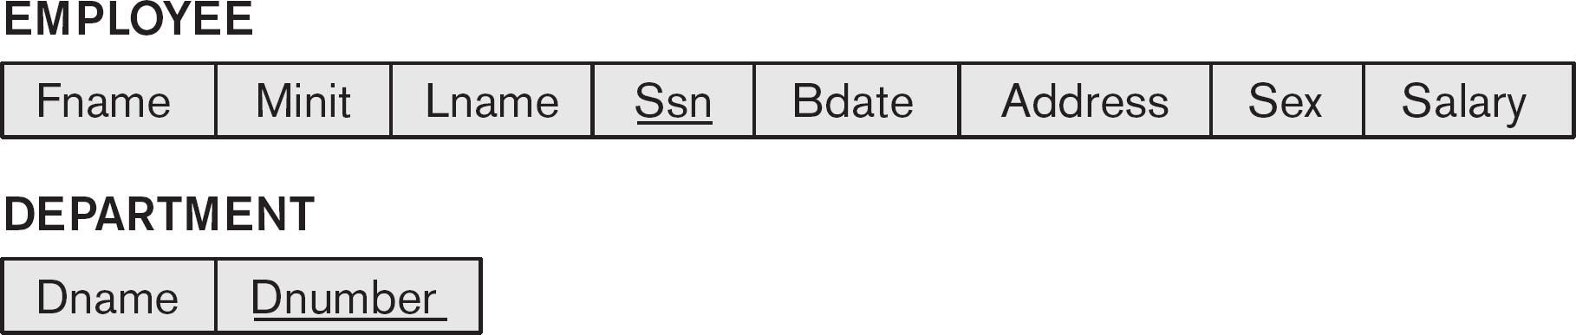
Step 2 Result
CS3200 – Database Design· ·· Spring 2018· ·· Derbinsky

Slide 15
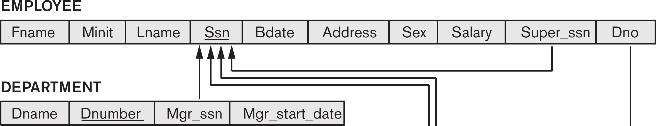
Step 3 Result
CS3200 – Database Design· ·· Spring 2018· ·· Derbinsky

Slide 16
Step 4: Binary 1-to-N
CS3200 – Database Design· ·· Spring 2018· ·· Derbinsky
Choose the S relation as the type at the N-side of the relationship, other is T
Add as a foreign key to S all of the primary key attribute(s) of T
Another approach: create a relationship relation

Slide 17
Example ERD
CS3200 – Database Design· ·· Spring 2018· ·· Derbinsky

Slide 18
Step 4 Result
CS3200 – Database Design· ·· Spring 2018· ·· Derbinsky

Slide 19
Step 5: Binary M-to-N
CS3200 – Database Design· ·· Spring 2018· ·· Derbinsky
Create a new relation S (termed:
relationship relation)
Add as foreign keys the primary keys of both relations; their combination forms the primary key of S
Add any simple attributes of the M:N relationship to S

Slide 20
Example ERD
CS3200 – Database Design· ·· Spring 2018· ·· Derbinsky

Slide 21
Step 5 Result
CS3200 – Database Design· ·· Spring 2018· ·· Derbinsky

Slide 22
Step 6: Multivalued Attributes
CS3200 – Database Design· ·· Spring 2018· ·· Derbinsky
Create a new relation S
Add as foreign keys the primary keys of the corresponding relation
Add the attribute to S (if composite, the simple attributes); the combination of all attributes in S forms the primary key

Slide 23
Example ERD
CS3200 – Database Design· ·· Spring 2018· ·· Derbinsky

Slide 24
Step 6 Result
CS3200 – Database Design· ·· Spring 2018· ·· Derbinsky

Slide 25
Mapping Hierarchical Entities
ER specialization or generalization comes in the form of hierarchical entity sets.

Slide 26
Mapping Hierarchical Entities
Mapping Hierarchical Procedure :
Create tables for all higher-level entities.
Create tables for lower-level entities.
Add primary keys of higher-level entities in the table of lower-level entities.
In lower-level tables, add all other attributes of lower-level entities.
Declare primary key of higher-level table and the primary key for lower-level table.
Declare foreign key constraints.

